Slide 1
ICLHE
AGM, 17 Oct. 2019
Financial Report & Budget

Slide 2
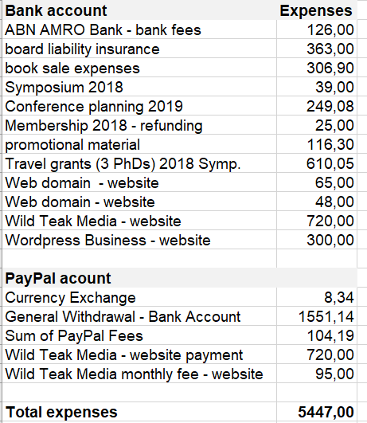
ICLHE Financial Activities July 2018 - June 2019 (in €) Balance Sheet, incl. bank account and PayPal account

Slide 3
